Slide 1
Project Proposal
Data Statistics SS 2022
Supervisor: Dr. Dinkelacker
Tutor: Ian ?
TRAs expression in Human Embryo Cells
Alina Aksianova, Letizia Holube, Nina Bank, Lydia Steiner

Slide 2
TRAs
Tissue Restricted Antigenes
Central tolerance of the immune system = Negative Selection process (Kyewski & Klein,2006)
Developing T-Cells -> exposed to TRAs in thymus -> binding cells apoptosis
Defect: Auto immune diseases, e.g. Diabetes Type I (Atkinson, Eisenbarth, Michels, 2014)
Application: Tumor Marker, Immunotherapy (Hong, 2014), (Mahmoud,2018)

Slide 3
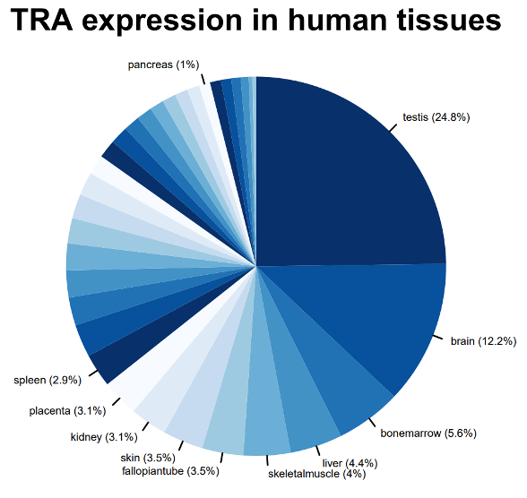
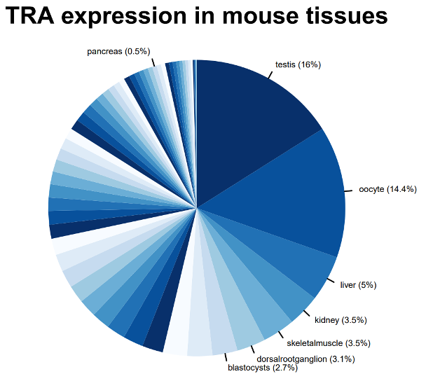
TRA-gene table
tra.2014.human.5x.table
ensembl.transcript | ensembl.gene | gene.symbol | entrezID | refseqID | unigeneID | chrom | startsite | tiss.number | tissues | max.tissue
ENST00000004103 | ENSG00000002933 | TMEM176A | 55365 | Hs.647116 | Hs.647116 | 7 | 150497491 | 2 | PB-CD14+Monocytes/Liver/kidney | Liver
Dinkelacker, 2007
Dinkelacker, 2019
Notes:
Datensatz kurz

Slide 4
Dataset
What did we choose, why did we choose it
Irie, N., & Kuratani, S. (2011). Comparative transcriptome analysis reveals vertebrate phylotypic period during organogenesis. Nature communications, 2, 248. https://doi.org/10.1038/ncomms1248
Gene Expression in mouse embryo development
Intervals: E7.5, E8.5, E9.5, E10.5, E12.5, E14.5, E16.5, E18.5 (days after mating)
each containig 2-3 samples with RNA of multiple whole embyos
Notes:
Phylotypic stage: developmental period in mid-embryogenesis where related species within a phylum (Tierstamm), highest resemblance
Datensatz erklären können

Slide 5
Chemokines
Notes:
Datensatz kurz

Slide 6
Paper vorstellen/Biologischer Background

Slide 7
Verknüpfung von Datenset und Biologie
Was sagt der Datensatz? Welche Zeilen? Was bedeuten die Zahlen etc?

Slide 8
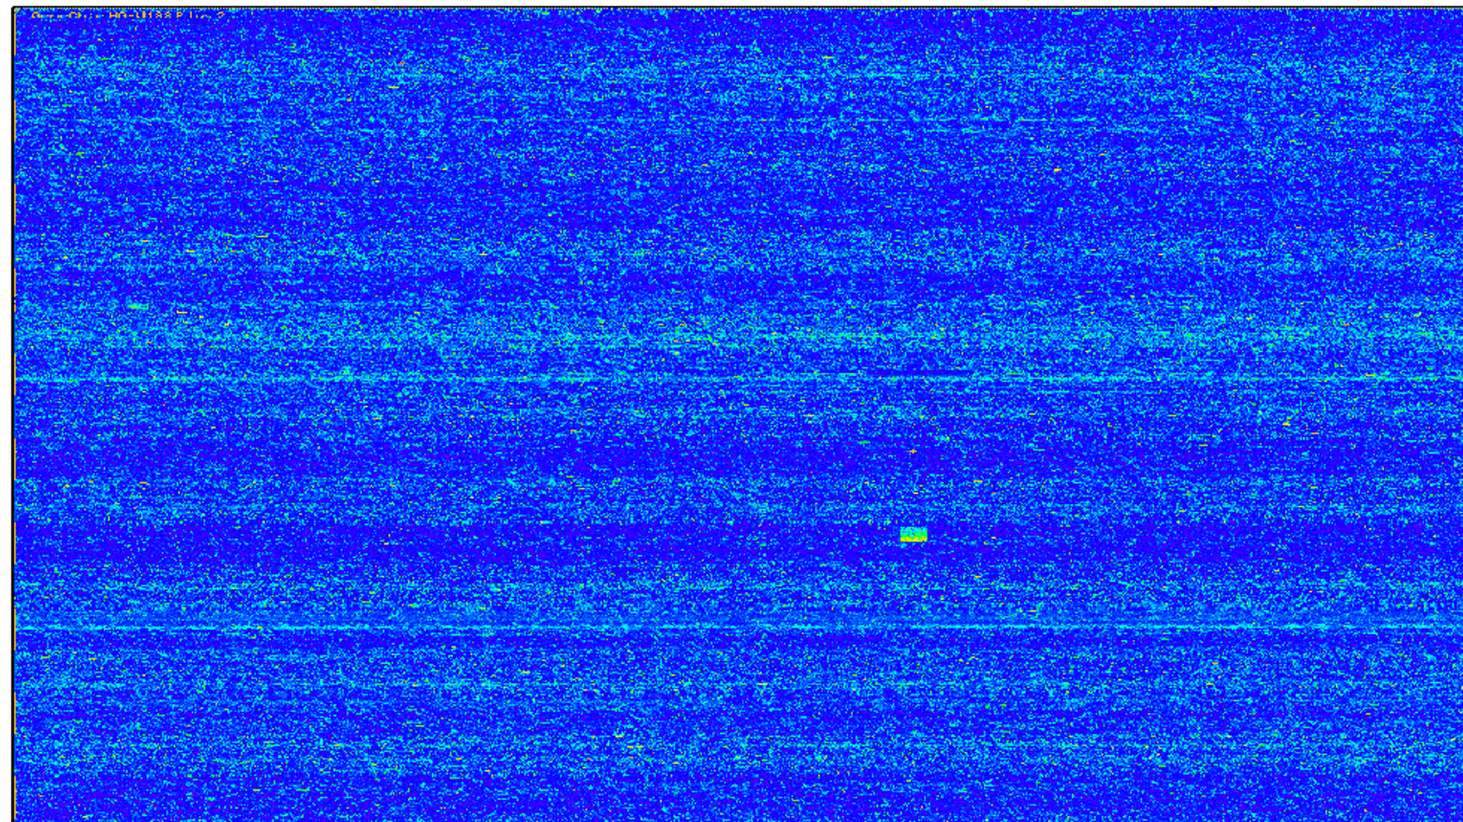
Microarrays
Gene Chip that reads gene expression in form of RNA
RNA -> cDNA -> labelling -> Hybridisation -> Scanning -> Data Acquisition
Labelling via biotin or Fluorescence
Brand of chip: Affymetrix Mouse Genome 430 2.0 Array
Internal Quality Control

Slide 9
Early organ development in mouse embryo

Slide 10
Methods
RNA degradation plot for quality control
VSNrma Normalisation
Boxplot before and after normalisation
If necessary Quantile normalisation
Scatter plot to control chip quality

Slide 11
Clean Data: Correctly assign gene names to Microarray dataset
New table with genes of low variance removed

Slide 12
Chipwise Quality Control
Maybe, we can try this out for a few chips and include some examples
Single cell control

Slide 13
“Hypothese”
How does the differential expression levels change over time of organogenesis in mice?
How does this data correlates with the known TRA-data?
Can we analyse Datensatz in Hinsicht auf den Chemokines
Whether there is a correlation with Chemokines or TRA?
E.g. how to combine with Chemokines, TRA?

Slide 14
Exploratory Dataanalysis
Histogramme
Density plots

Slide 15
What have we done until now?
Here we are
Week 1
Week 2-3
Week 4-6
Week 7-8
13.07. 2022
Data Camp
Github
Organization
Data Exploration
Quality Control
PCA, heatmaps
k-means
differential gene expression
Compare to literature
Bug Fixes
Finish presentation and report
Presentation
Notes:
Erste Folie: was wir bisher gemacht haben
Zweite folie: was noch kommt und dann spezifischer
Sauber Einteilen!!!!

Slide 16
Spezifizierte milestones
Data Exploration: xy
Bioanatytics:
PCA, heatmaps
k-means
differential gene expression
Compare to literature

Slide 17
Timeline
Week 1
Week 2-3
Week 4-6
Week 7-8
13.07. 2022
Data Camp
Github
Organization
Data Exploration
Quality Control
PCA, heatmaps
k-means
differential gene expression
Compare to literature
Bug Fixes
Finish presentation and report
Presentation

Slide 18
References

